Slide 1
CHAPTER 7.1: Graphing Ordered Pairs
Algebra concepts

Slide 2
Objective
Students will plot points using the coordinate system.
Students will identify the quadrant associated with a point.
Students will identify the coordinates of a point.

Slide 3
Definitions
Graph: a point which is an ordered pair of numbers on a plane.
X-Axis: the horizontal axis
Y-Axis: the vertical axis
Origin: the point where the axes cross (0,0)
Coordinate Plane: the plane containing the points and axes.
Coordinates: the numbers in an ordered pair
X-Coordinate: the first number in an ordered pair
Y-Coordinate: the second number in an ordered pair

Slide 4
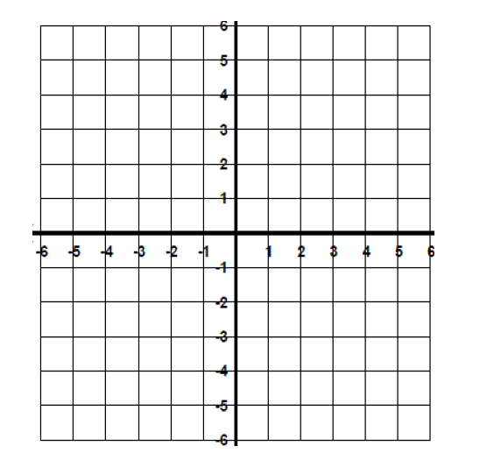
$$Coordinate Plane$$

Slide 5
Plot the Points
A (3,4)
B (4,3)
C (-3,4)
D (2,-5)
E (-4,-4)
F (4,6)
G (6,4)
H (-2,5)
I (-3,-3)
J (5,-3)

Slide 6
Points with 0’s
These points will be on either the x or y axis
If the x value is the 0, the point will be on the y-axis
If the y value is the 0, the point will be on the x-axis

Slide 7
Plot the Points
A (0, -3)
B (-2, 0)
C (0, 7)
D (5, 0)
E (0, -5)
F (-6, 0)

Slide 8
In which quadrant is each point located?
1. (4, -5)
2. (2, 2)
3. (-1, -3)
4. (-6, 1)
5. (-4, 0)
6. (5, 3)
7. (-6, -4)
8. (10, -14)
9. (-13, 4)

Slide 9
Find the Coordinates of the Point
A ( )
B ( )
C ( )
D ( )
E ( )
F ( )

